Slide 1


Veloces : Efficient I/O Scheduler for Solid State Devices
Guided By – G.P.Potdar
HOD Comp, PICT
Vishakha damle
Amogh Palnitkar
Om Pawar
Sarvesh Rangnekar
External Guide –
Mr. Swapnil Pimpale
Ms. Nafisa Mandliwala
L3CUBE

Slide 2


Slide 3
Overview
Solid State Devices
SSD vs HDD
I/O Scheduler
Current Schedulers
Idea
Performance

Slide 4
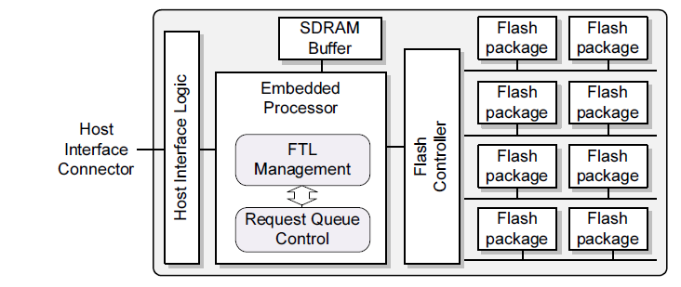
Solid State Devices
Data storage device
Store data persistently
NAND-based flash memory
Properties –
High speed.
Less access time.
Less latency.
Block Diagram

Slide 5
SSD vs HDD
Point of Difference | SSD | HDD
Read/write symmetry | Lower write speed | Comparable speeds
Data transfer rate | Very high (R/W) – 450/300 Mbps | Much lower (R/W) – 130/130 Mbps
Internal Structure | NAND-based flash memory | Electromechanical Magnetic Disk
Random access | Fairly better than HDD | Very low compared to SSD
Spatial Location Dependent

Slide 6
I/O Scheduler
One which decides the order of block I/O operations
Minimize access time
Share I/O devices
Performs merging of requests
User Space
I/O Requests
Block Layer
I/O Scheduler

Slide 7
Schedulers
No-op
Deadline
Complete Fair Queuing(CFQ)

Slide 8
Noop Scheduler
simple FIFO queue
Implements request merging
Disadvantage for SSD:
Does not consider properties of SSD
R2
R3
R2
R3
R1
R1
R3
R2+R3
R2
R1
R1

Slide 9
Deadline Scheduler
?
Imposing a deadline on all I/O operations
Read and write FIFO queues and a sorted queue
Disadvantage for SSD:
Overhead of arranging requests according to sector
W3
W2
W1
R3
R2
R1
?
R1
WR3
WR2
WR1
WR1

Slide 10
CFQ Scheduler
Sorted sector-wise
Per-process queues
Service queues Round Robin
Ensures fairness
Disadvantage for SSD:
Overhead of sector wise sorting of requests
R3
R2
R1
R1
R3
R2
R1
R1
R3
R2
R1
R1

Slide 11
Problem Definition
To build an I/O scheduler for Flash Based Devices in order to optimize the throughput of block device for read write operations.

Slide 12
Features of ‘Veloces’ Scheduler
Read Preference
Front Merging
Block Boundary

Slide 13
Read Preference
Suffer from erase-before-write limitation
Reads faster than writes
Synchronous nature of reads

Slide 14
How do we implement?
W3
W2
W1
Check for deadline?
Write queue
W1
R1
Read queue
R3
R2
R1
R2

Slide 15
Front Merging
Existing schedulers implement back merging.
No heads in SSDs, direction is not important.
Hence, scheduler merges “Front” Requests too.
R3
R2
R1
2048-2060
2048-2078
2060-2078

Slide 16
Block Boundary
Penalty of crossing block
Dispatching write requests in the same block as far as possible
Buddy of a request ‘X’ is a request ‘Y’ which lies in the same block as the ‘X’
R2
R3
R4
R1
Current request
Check for buddy

Slide 17
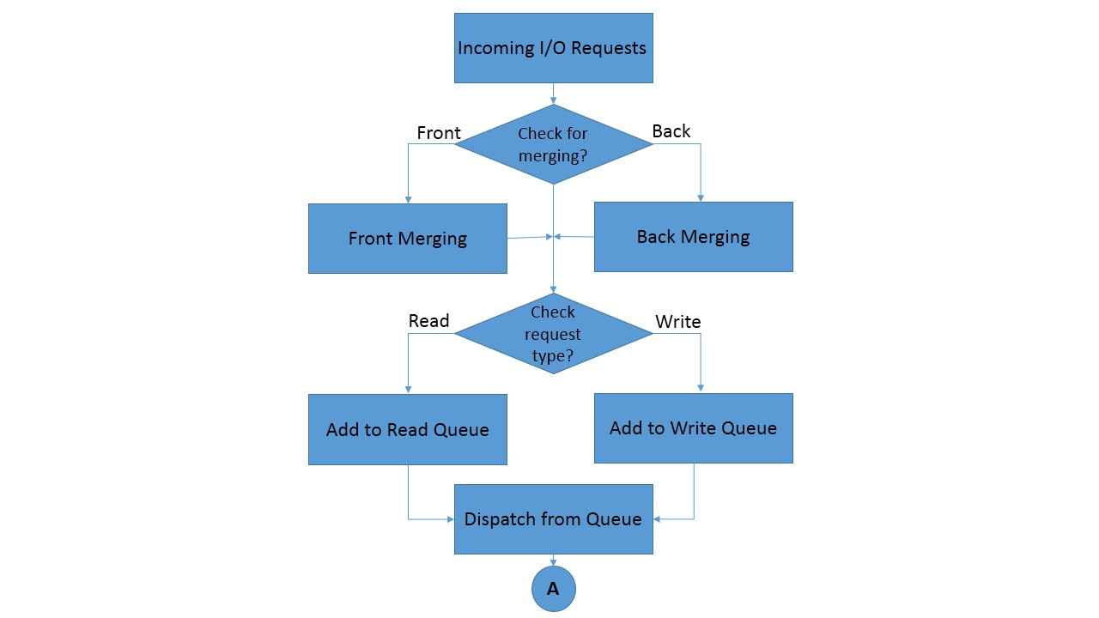

Slide 18
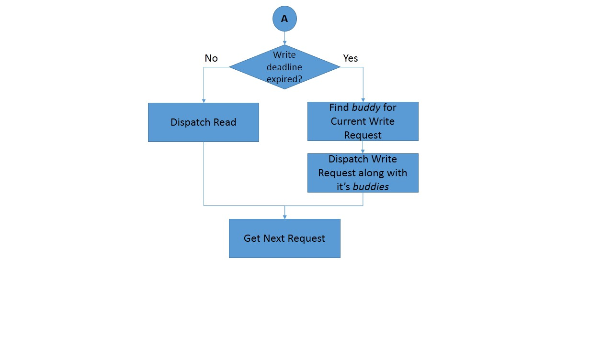

Slide 19
Tunables
write_expire
Tuning the deadline of the write requests.
max_count
Maximum number of write requests to be checked and dispatched as a bundle.

Slide 20
Testing Platform
Ubuntu 12.04 LTS , kernel 3.7.x
Model : Intel(R) Dual Core(TM) @ 2.20GHz
1GB RAM
Benchmarks used –
FIO (Flexible I/O)
Filebench
TIObench
Postmark

Slide 21
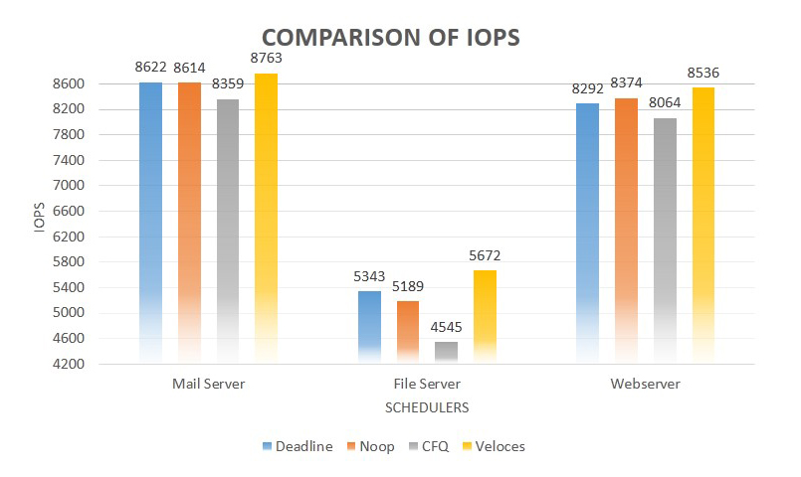
Result and Performance

Slide 22
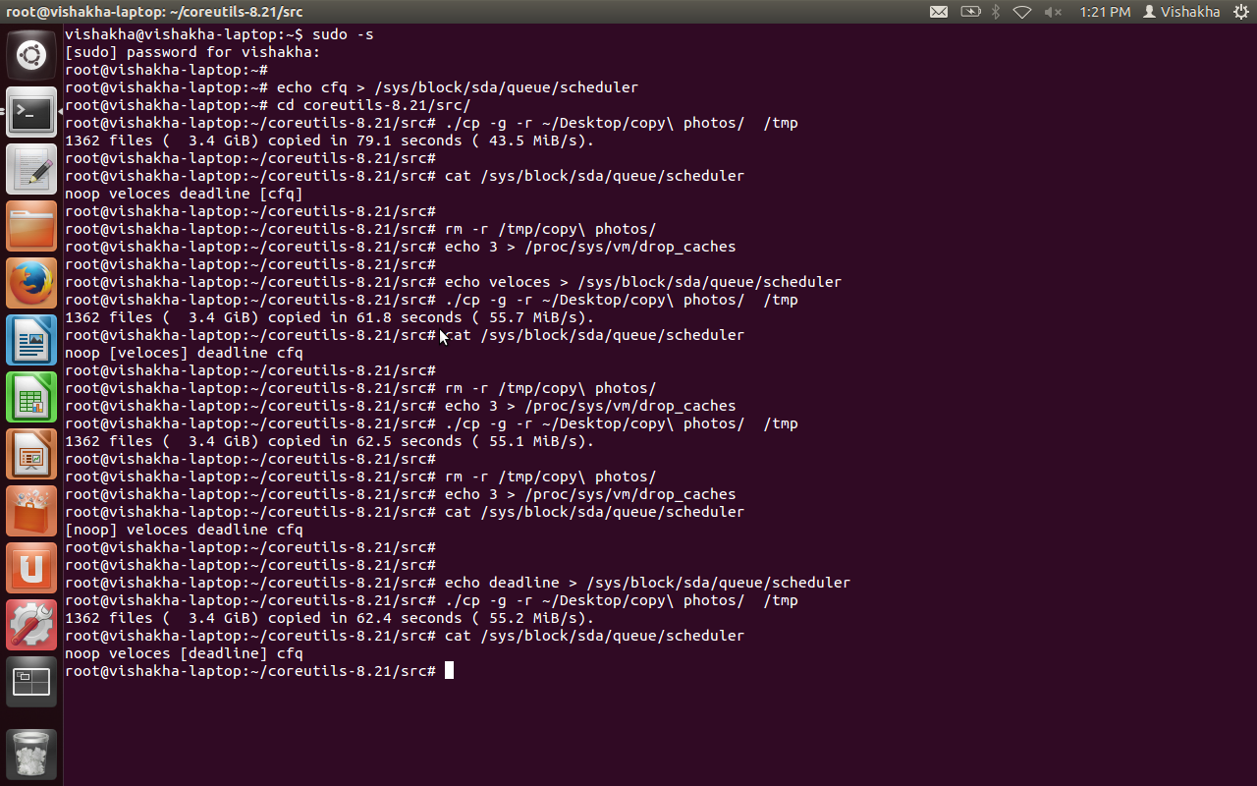

Slide 23
Achievements and Recognition
Paper accepted at Linux Symposium 2014 Ottawa, Canada.
1st in Project Competition ( SoftKRITI ) at ‘Techkriti’ IIT-Kanpur.
1st in Paper Presentation ( Eureka ) at ‘Techkriti’ IIT-Kanpur.
GitHub Repo
http://www.github.com/amoghpalnitkar/veloces

Slide 24
References
M. Dunn and A.L.N. Reddy, A new I/O scheduler for solid state devices. Tech. Rep. TAMU-ECE-2009-02, Department of Electrical and Computer Engineering, Texas A&M University, 2009.
J. Kim, Y. Oh, E. Kim, J. Choi, D. Lee, and S.H. Noh, Disk schedulers for solid state drivers. In Proc. EMSOFT(2009), PP. 295-304.
Wang H., Huang P., He S., Zhou K., Li C., and He X. A novel I/O scheduler for SSD with improved performance and lifetime. Mass Storage Systems(MSST), 2013 IEEE 29th Symposium, 1-5.
S. Kang, H. Park, C. Yoo, Performance enhancement of I/O scheduler for solid state device. In 2011 IEEE International Conference on Consumer Electronics, 31-32
S. Park and K. Shen, "Fios: A fair, efficient flash i/o scheduler," in FAST, 2012.
Y. Hu, H. Jiang, L. Tian, H. Luo, and D. Feng, “Performance impact and interplay of ssd parallelism through advanced commands, allocation strategy and data granularity,” in Proceedings of the 25th International Conference on Supercomputing(ICS’2011), 2011.
J. Axboe. Linux block IO — present and future. In Ottawa Linux Symp., pages 51–61, Ottawa, Canada, July 2004.

Slide 25
Thank you

